Slide 1
QMST 5335
ARIMA Overview and Hierarchical Time Series

Slide 2
Learning Objectives:
ARIMA overview
  Learning the basics of ARIMA models
  ARIMA Modeling basics
  Forecasting with ARIMA models
Hierarchical/Grouped time series forecasting
  What is a hierarchical/grouped time series?
  Single level approaches for forecasting hierarchical/grouped time series

Slide 3
Outline
ARIMA Overview
  Introduction to ARIMA, Transformation and Differencing
  Autoregressive models, Moving Average models
  Non-seasonal ARIMA model, Order Selection and Parameter Estimation
  ARIMA Modeling and Forecasting with ARIMA, ARIMA vs. ETS
Hierarchical/Group Time Series Forecasting
  Hierarchical/Group Time Series, Single Level Forecasting Approaches
  Bottom-up, Top-down, and Middle-out Approaches

Slide 4
Outline
ARIMA Overview
  Introduction to ARIMA, Transformation and Differencing
  Autoregressive models, Moving Average models
  Non-seasonal ARIMA model, Order Selection and Parameter Estimation
  ARIMA Modeling and Forecasting with ARIMA, ARIMA vs. ETS
Hierarchical/Group Time Series Forecasting
  Hierarchical/Group Time Series, Single Level Forecasting Approaches
  Bottom-up, Top-down, and Middle-out Approaches

Slide 5
Introduction to ARIMA
Autoregressive Integrated Moving Average (ARIMA) models are alternative approaches for time series forecasting
  ETS and ARIMA models are the most common approaches for forecasting time series
    ETS methods describe and use trend and seasonality in the data
    ARIMA models aim to describe autocorrelations in the data
ARIMA models combine two models:
  Autoregressive models: regression of the variable against itself
  Moving average models: regression of the variable against past forecast errors
Basic ARIMA models work on stationary time series
  What if a time series is not stationary?
  Transformations can be used to stabilize the variance
  Differencing is used to represent a time series as a stationary one

Slide 6
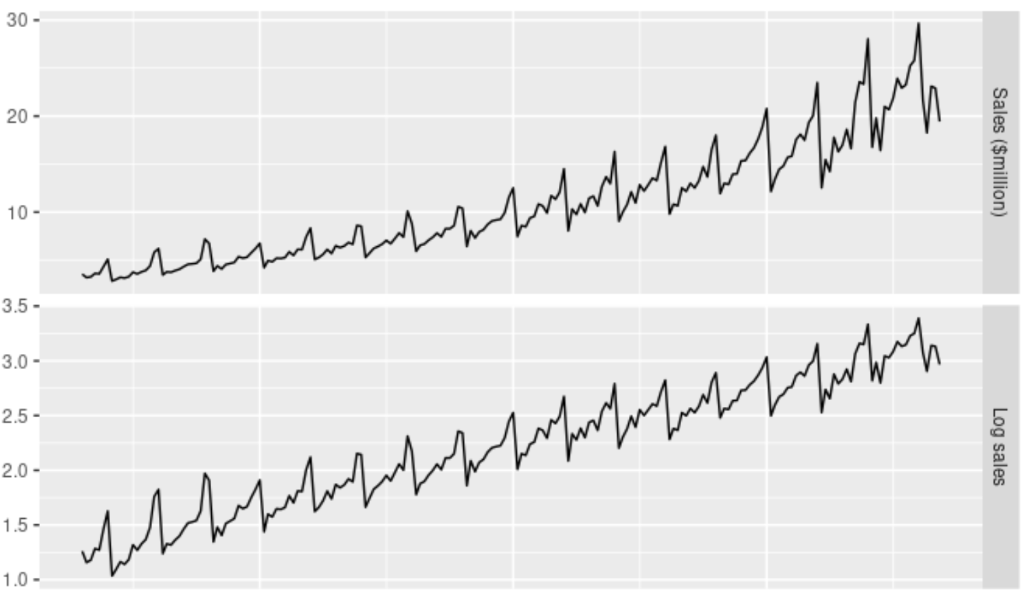
Transformations
Transformations such as logarithms can help stabilize the variance of a time series
  Typically, transformation is applied before differencing

Slide 7
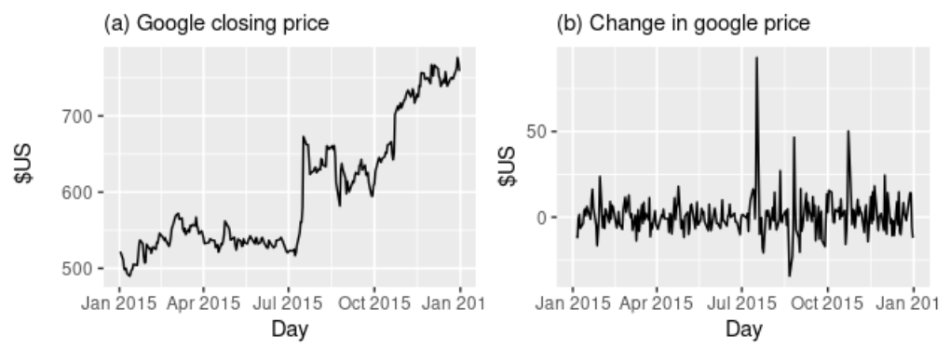
Differencing
One way to make a non-stationary time series stationary is to compute the differences between consecutive observations
  This is known as differencing
  Illustration:
Differencing can help stabilize the mean of a time series by removing changes in the level of a time series
  Therefore eliminating (or reducing) trend and seasonality

Slide 8
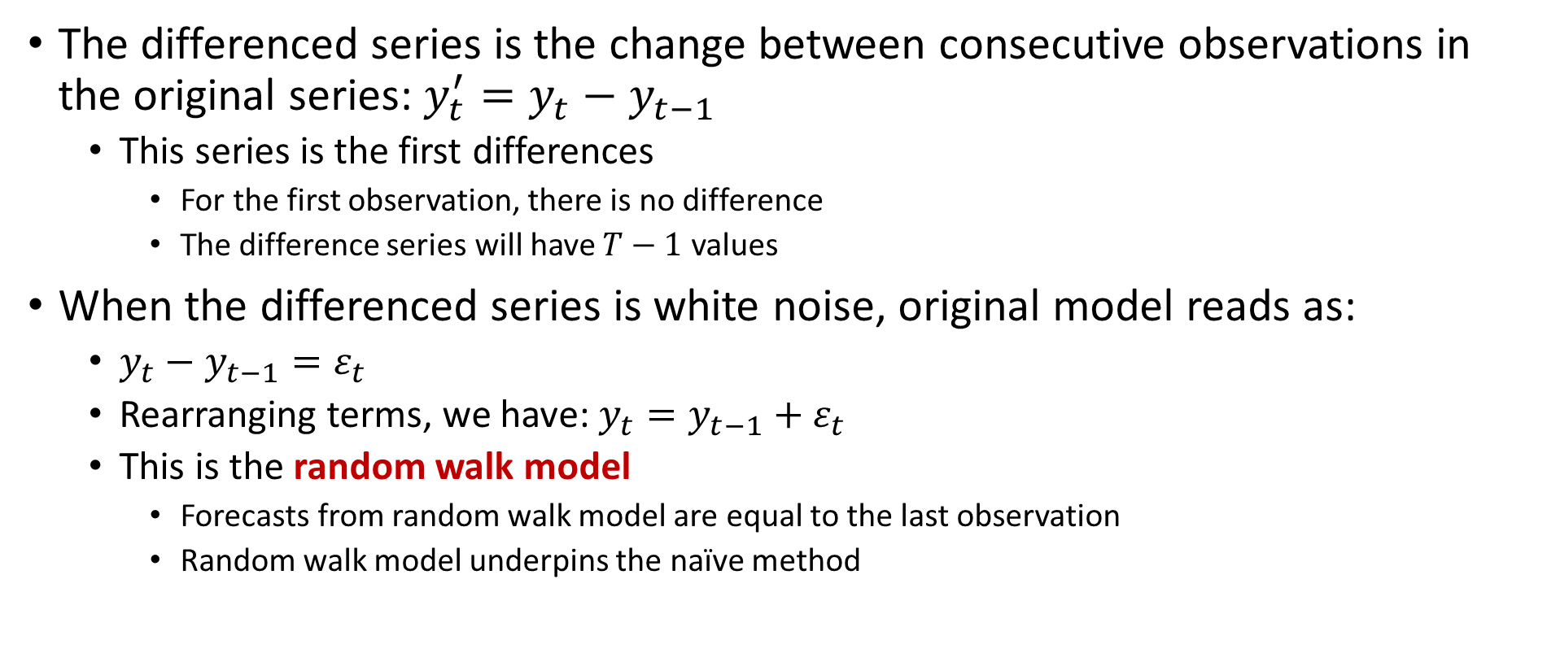
Differencing
The differenced series is the change between consecutive observations in the original series: $y_{t}^{′}=y_{t}−y_{t−1}$
  This series is the first differences
    For the first observation, there is no difference
    The difference series will have $T−1$ values
When the differenced series is white noise, original model reads as:
  $y_{t}−y_{t−1}=ε_{t}$
  Rearranging terms, we have: $y_{t}={y_{t−1}+ε}_{t}$
  This is the random walk model
    Forecasts from random walk model are equal to the last observation
    Random walk model underpins the naïve method

Slide 9
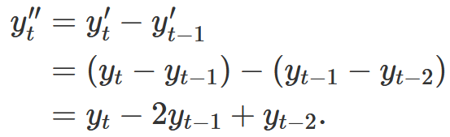
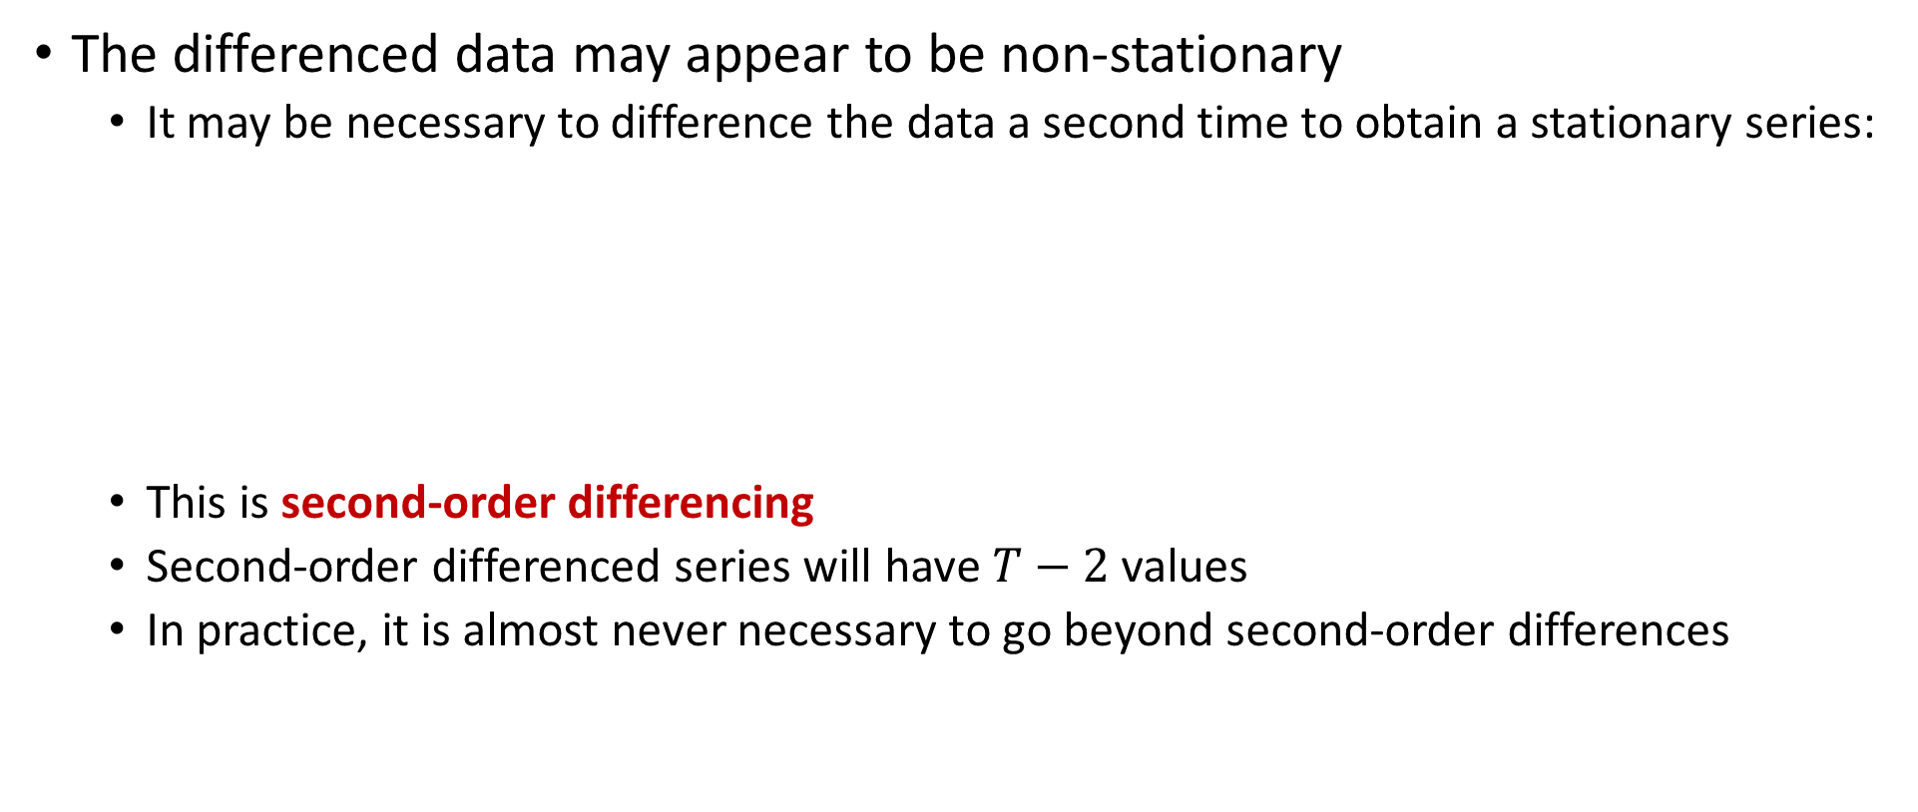
Differencing
The differenced data may appear to be non-stationary
  It may be necessary to difference the data a second time to obtain a stationary series:
  This is second-order differencing
  Second-order differenced series will have $T−2$ values
  In practice, it is almost never necessary to go beyond second-order differences

Slide 10
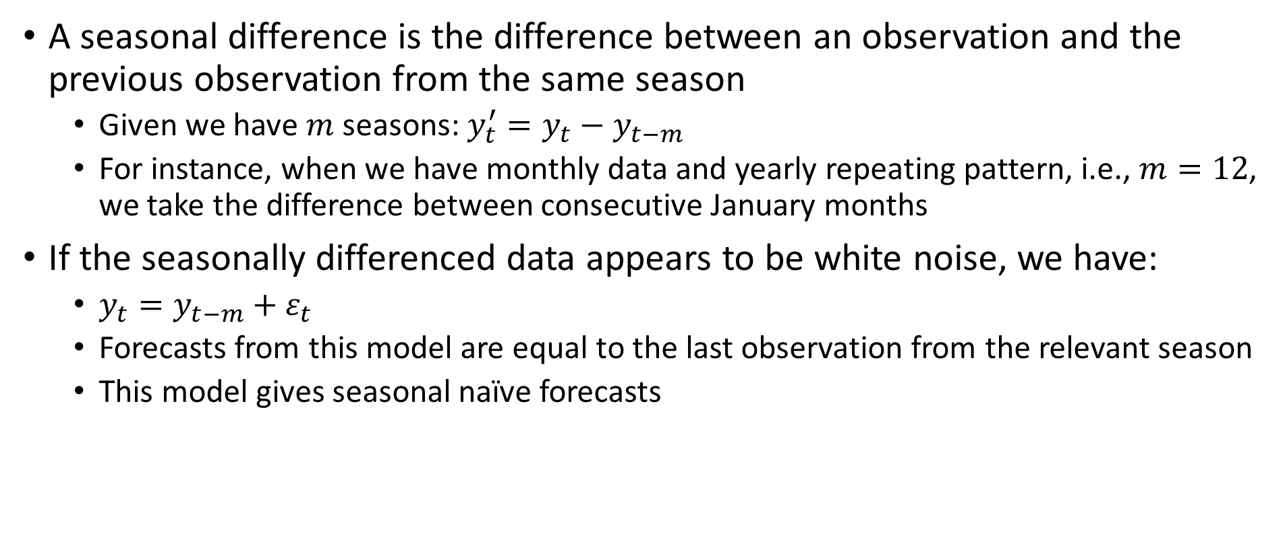
Seasonal Differencing
A seasonal difference is the difference between an observation and the previous observation from the same season
  Given we have $m$ seasons: $y_{t}^{′}=y_{t}−y_{t−m}$
  For instance, when we have monthly data and yearly repeating pattern, i.e., $m=12$, we take the difference between consecutive January months
If the seasonally differenced data appears to be white noise, we have:
  $y_{t}={y_{t−m}+ε}_{t}$
  Forecasts from this model are equal to the last observation from the relevant season
  This model gives seasonal naïve forecasts

Slide 11
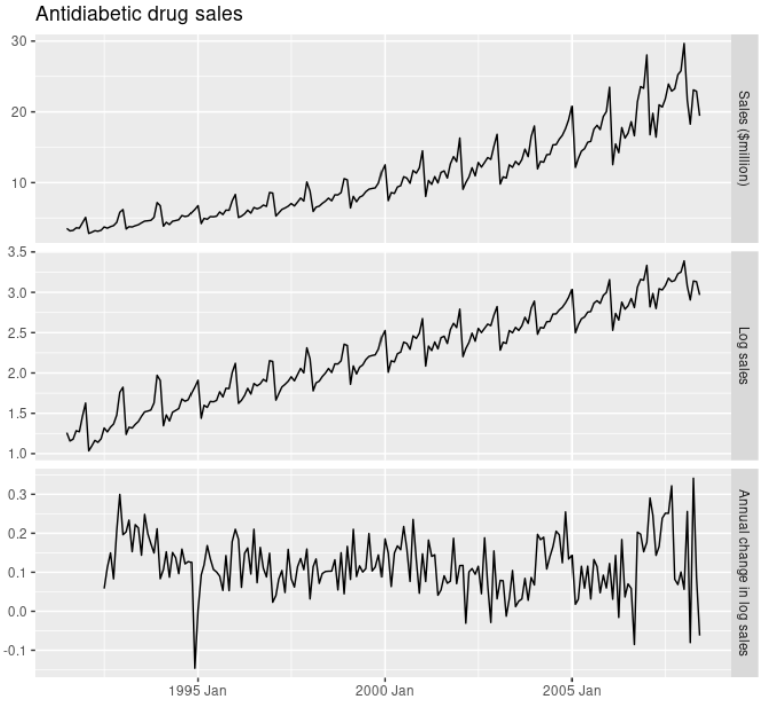
Seasonal Differencing
Illustration:
  The logarithms stabilize the variance
  The seasonal differences remove the seasonality and trend
  Relatively stationary

Slide 12
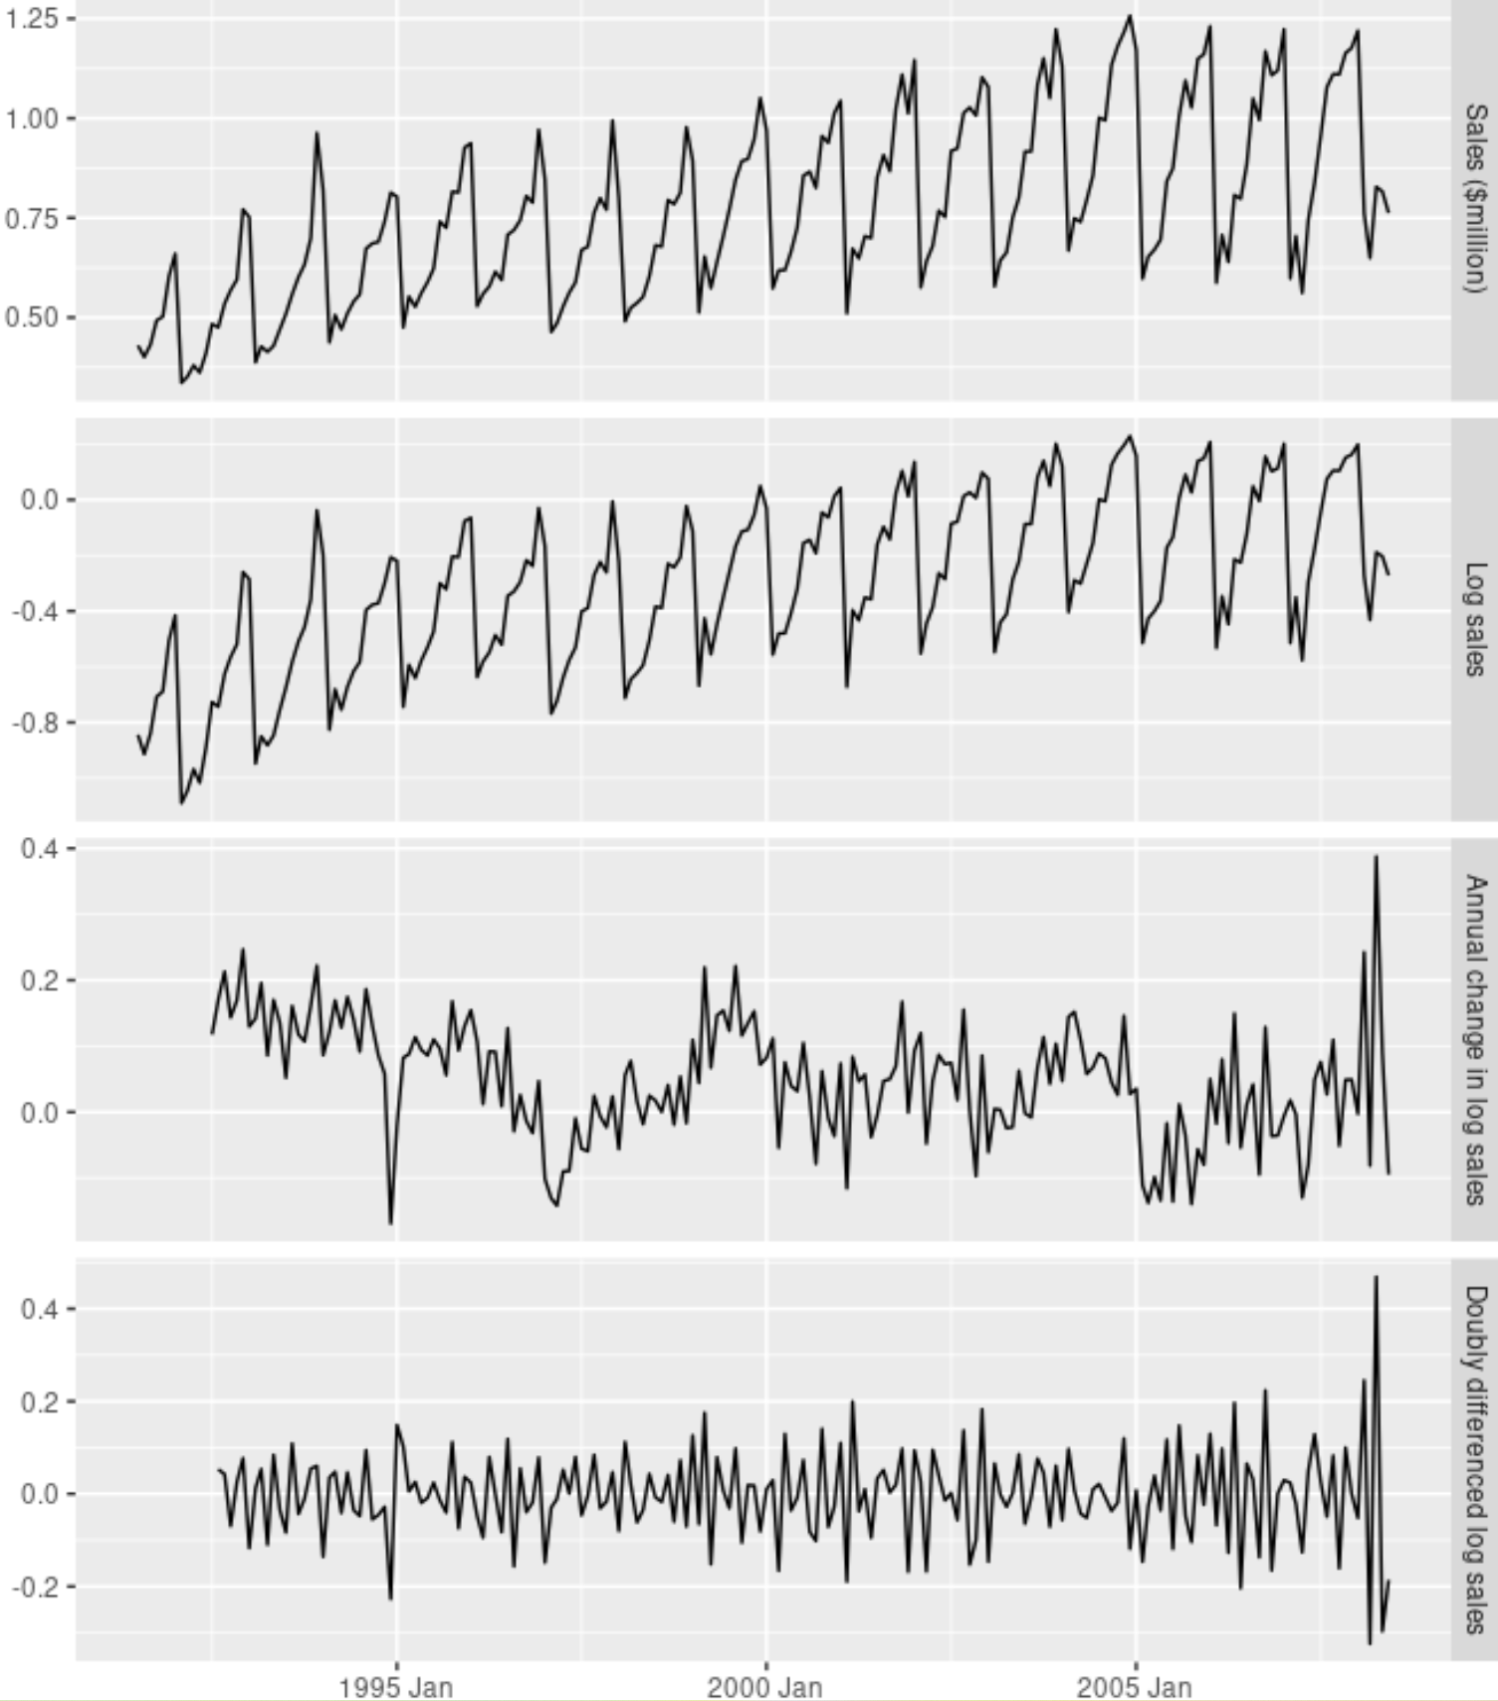
Seasonal Differencing
Sometimes it is necessary to take both a seasonal difference and a first difference to obtain stationary data
  Sales
  Log Sales
  Seasonal differencing
  First differencing

Slide 13
Differencing Remarks
There is subjectivity in selecting which differences to apply
  When both seasonal and first differences are applied, it makes no difference which is done first—the result will be the same
    If data have a strong seasonality, it is recommended that seasonal differencing be done first because the resulting series will sometimes be stationary and there will be no need for a further first difference
    If first differencing is done first, there will still be seasonality present
Some remarks:
  Applying more differences than required will induce false dynamics or autocorrelations that do not really exist in the time series
    Therefore, do as few differences as necessary to get stationary series
  It is important that if differencing is used, the differences are interpretable
    First differences are the change between one observation and the next
    Seasonal differences are the change between one year to the next
    Other lags are unlikely to be much interpretable and should be avoided
  We can use unit root tests to decide if differencing is needed
    Apply unit root test to see if first-differencing needed
    Apply unit root test to the differenced series to see if further differencing needed

Slide 14
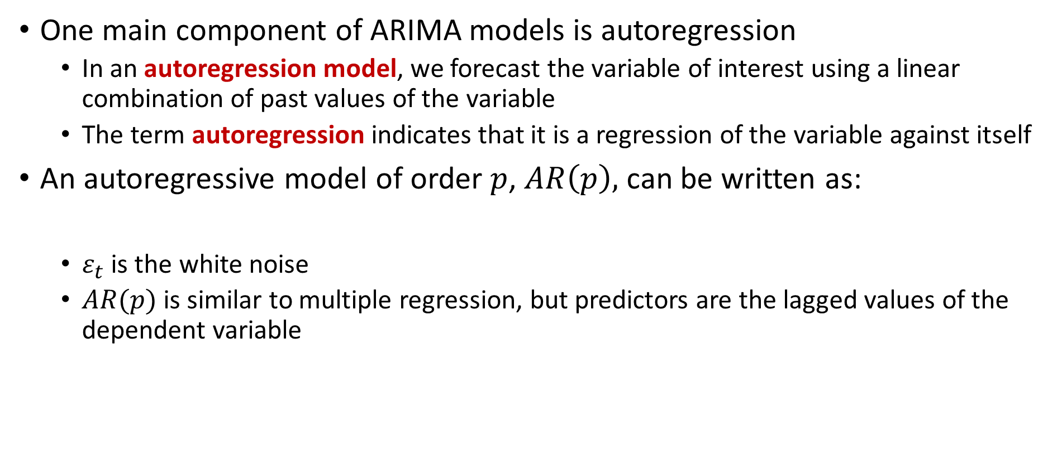
Autoregressive Models
One main component of ARIMA models is autoregression
  In an autoregression model, we forecast the variable of interest using a linear combination of past values of the variable
  The term autoregression indicates that it is a regression of the variable against itself
An autoregressive model of order $p$, $AR\left(p\right),$ can be written as:
  $ε_{t}$ is the white noise
  $AR(p)$ is similar to multiple regression, but predictors are the lagged values of the dependent variable

Slide 15
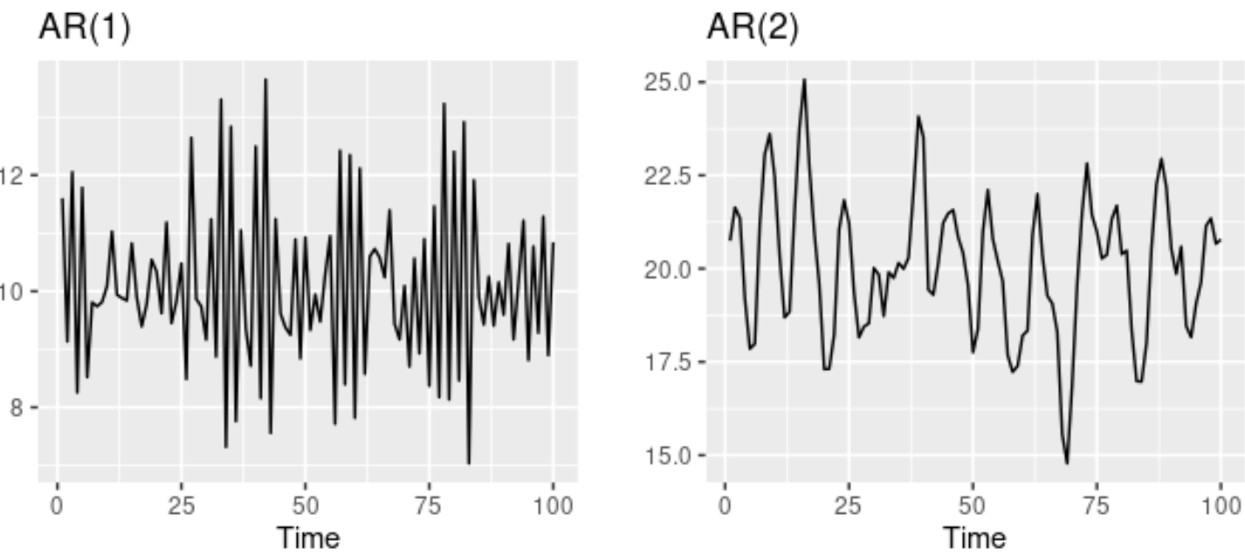

Autoregressive Models
Autoregressive models are remarkably flexible at handling a wide range of different time series patterns
AR(1) with $y_{t}=18−0.8y_{t}−1+ε_{t}$ AR(2) with $y_{t}=8+1.3y_{t}−1−0.7y_{t}−2+ε_{t}$

Slide 16
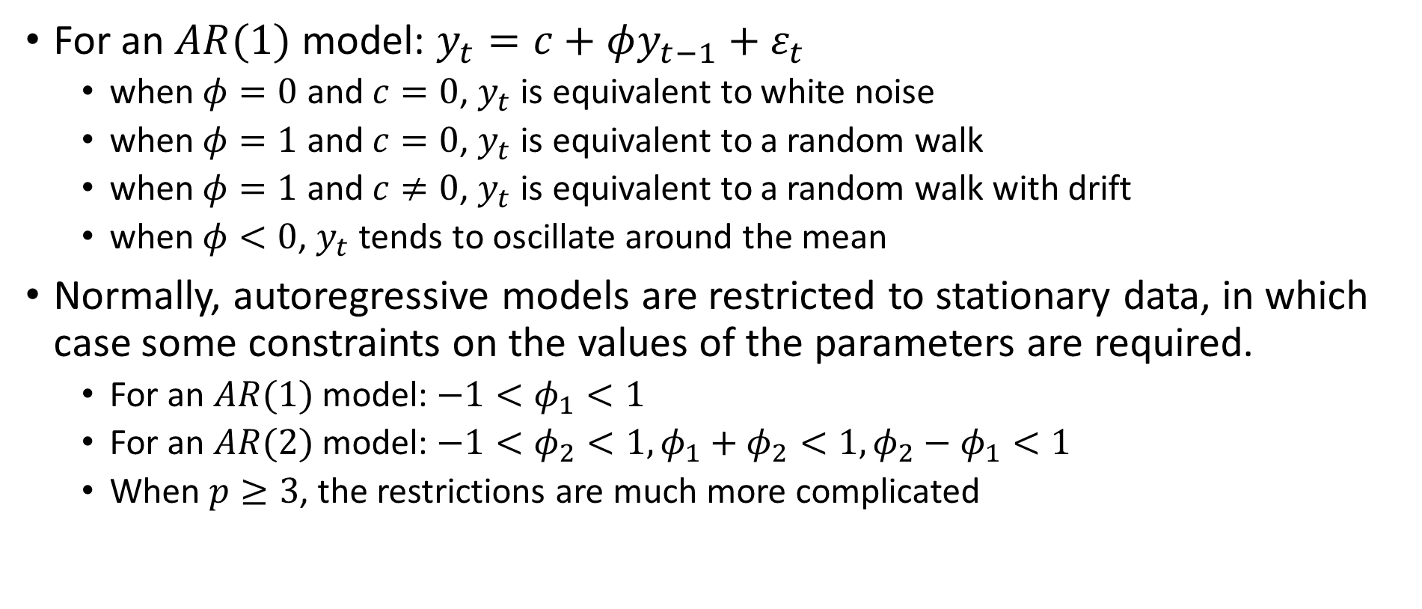
Autoregressive Models
For an $AR(1)$ model: $y_{t}=c+φy_{t−1}+ε_{t}$
  when $φ=0$ and $c=0$, $y_{t}$ is equivalent to white noise
  when $φ=1$ and $c=0$, $y_{t}$ is equivalent to a random walk
  when $φ=1$ and $c≠0$, $y_{t}$ is equivalent to a random walk with drift
  when $φ<0$, $y_{t}$ tends to oscillate around the mean
Normally, autoregressive models are restricted to stationary data, in which case some constraints on the values of the parameters are required.
  For an $AR(1)$ model: $−1<φ_{1}<1$
  For an $AR(2)$ model: $−1<φ_{2}<1, φ_{1}+φ_{2}<1, φ_{2}−φ_{1}<1$
  When $p≥3$, the restrictions are much more complicated

Slide 17
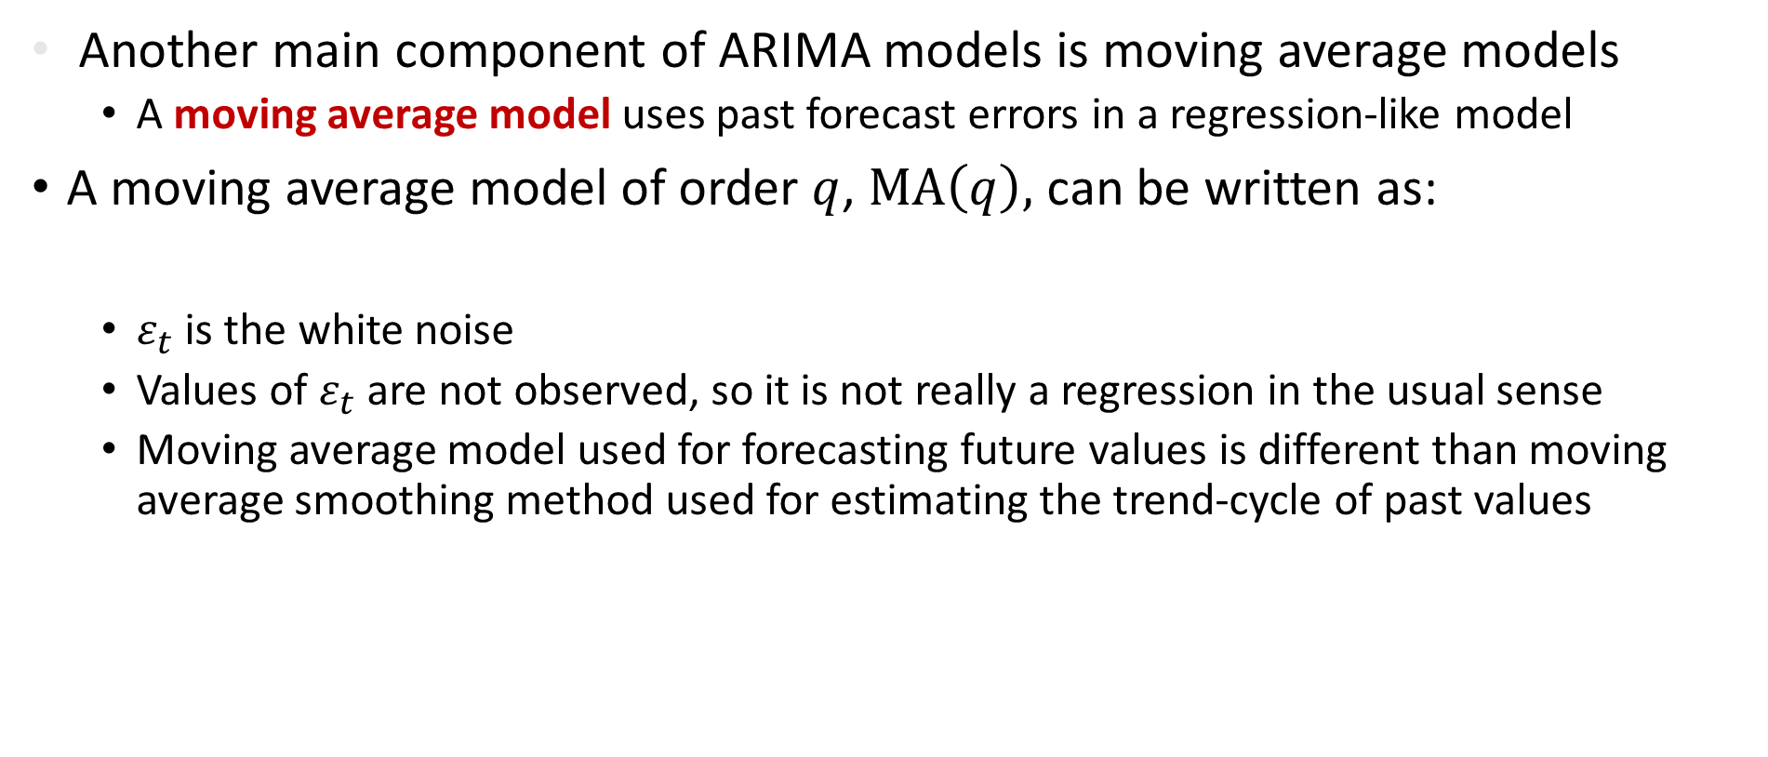
Moving Average Models
Another main component of ARIMA models is moving average models
  A moving average model uses past forecast errors in a regression-like model
A moving average model of order $q$, $MA\left(q\right),$ can be written as:
  $ε_{t}$ is the white noise
  Values of $ε_{t}$ are not observed, so it is not really a regression in the usual sense
  Moving average model used for forecasting future values is different than moving average smoothing method used for estimating the trend-cycle of past values

Slide 18
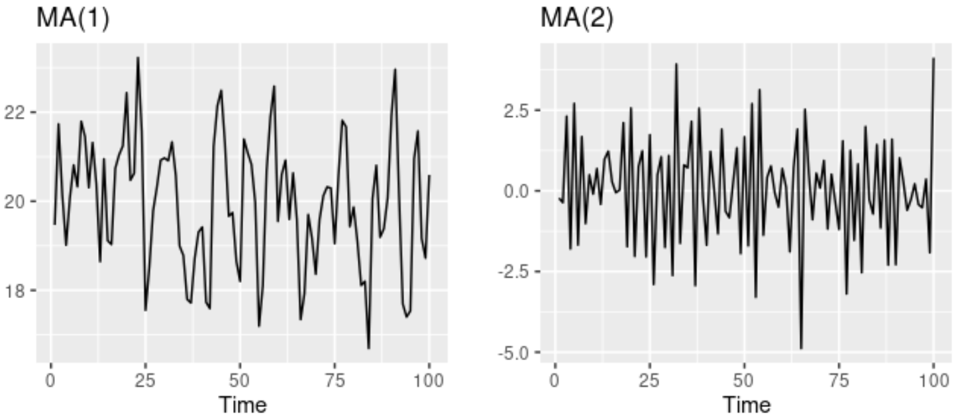

Moving Average Models
Changing the parameters $θ_{1},…,θ_{q}$ results in different time series patterns
MA(1) with $y_{t}=20+ε_{t}+0.8ε_{t−1}$ and MA(2) with $y_{t}=ε_{t}−ε_{t−1}+0.8ε_{t−2}$

Slide 19
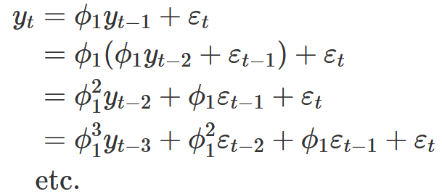
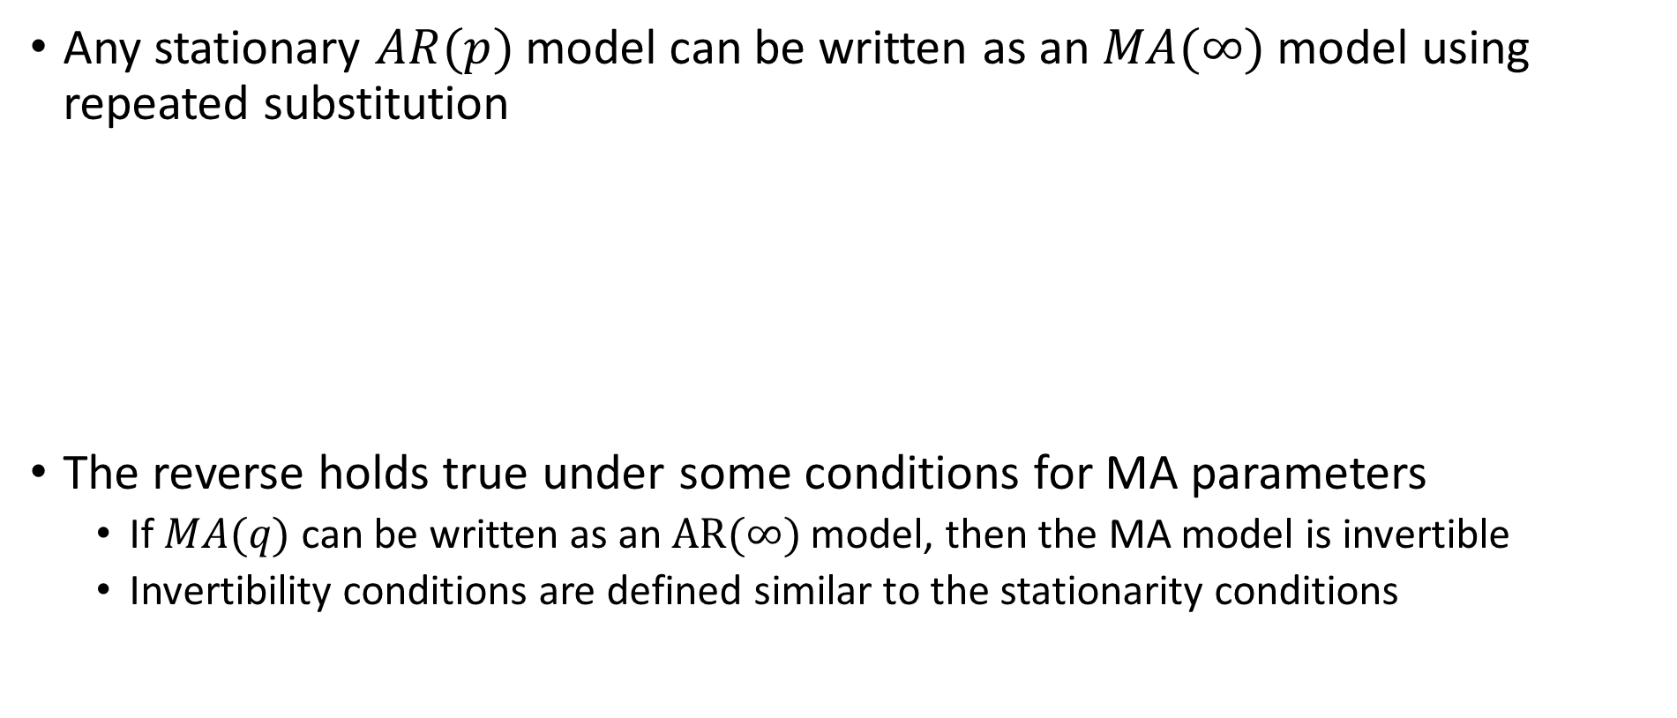
Moving Average Models
Any stationary $AR(p)$model can be written as an $MA(∞)$ model using repeated substitution
The reverse holds true under some conditions for MA parameters
  If $MA(q)$ can be written as an $AR(∞)$ model, then the MA model is invertible
  Invertibility conditions are defined similar to the stationarity conditions

Slide 20
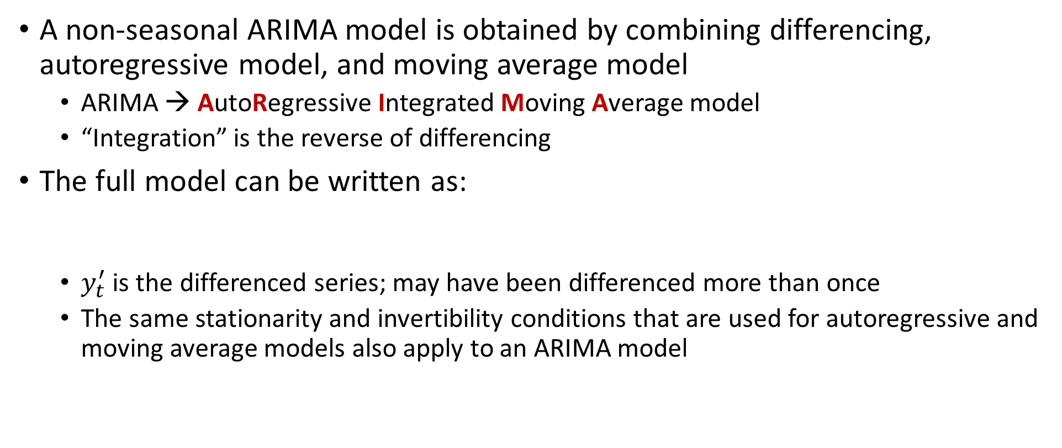
Non-seasonal ARIMA Model
A non-seasonal ARIMA model is obtained by combining differencing, autoregressive model, and moving average model
  ARIMA → AutoRegressive Integrated Moving Average model
  “Integration” is the reverse of differencing
The full model can be written as:
  $y_{t}^{′}$ is the differenced series; may have been differenced more than once
  The same stationarity and invertibility conditions that are used for autoregressive and moving average models also apply to an ARIMA model

Slide 21
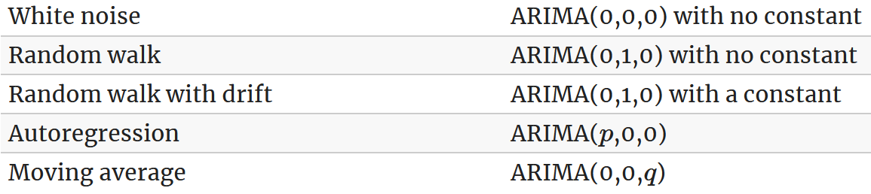

Non-seasonal ARIMA Model
$ARIMA(p,d,q)$model:
  $p=$order of the autoregressive part;
  $d=$degree of first differencing involved;
  $q=$order of the moving average part.
Special cases:

Slide 22
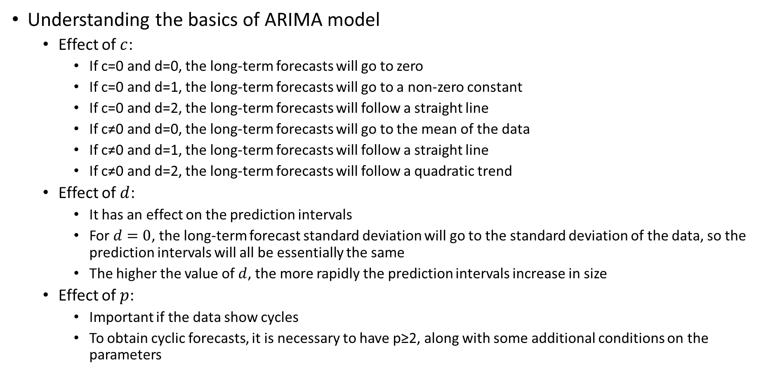
Non-seasonal ARIMA Model
Understanding the basics of ARIMA model
  Effect of $c$:
    If c=0 and d=0, the long-term forecasts will go to zero
    If c=0 and d=1, the long-term forecasts will go to a non-zero constant
    If c=0 and d=2, the long-term forecasts will follow a straight line
    If c≠0 and d=0, the long-term forecasts will go to the mean of the data
    If c≠0 and d=1, the long-term forecasts will follow a straight line
    If c≠0 and d=2, the long-term forecasts will follow a quadratic trend
  Effect of $d$:
    It has an effect on the prediction intervals
    For $d=0$, the long-term forecast standard deviation will go to the standard deviation of the data, so the prediction intervals will all be essentially the same
    The higher the value of $d$, the more rapidly the prediction intervals increase in size
  Effect of $p$:
    Important if the data show cycles
    To obtain cyclic forecasts, it is necessary to have p≥2, along with some additional conditions on the parameters

Slide 23
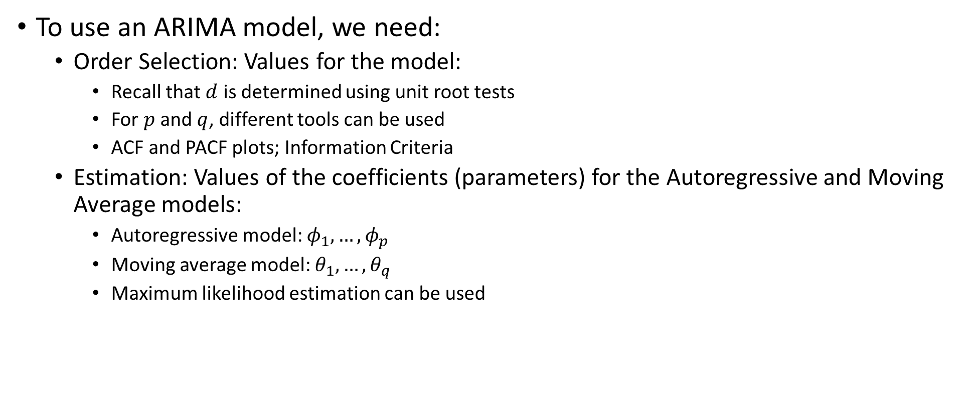
Order Selection and Estimation
To use an ARIMA model, we need:
  Order Selection: Values for the model:
    Recall that $d$ is determined using unit root tests
    For $p$ and $q$, different tools can be used
    ACF and PACF plots; Information Criteria
  Estimation: Values of the coefficients (parameters) for the Autoregressive and Moving Average models:
    Autoregressive model: $φ_{1},…,φ_{p}$
    Moving average model: $θ_{1},…,θ_{q}$
    Maximum likelihood estimation can be used

Slide 24
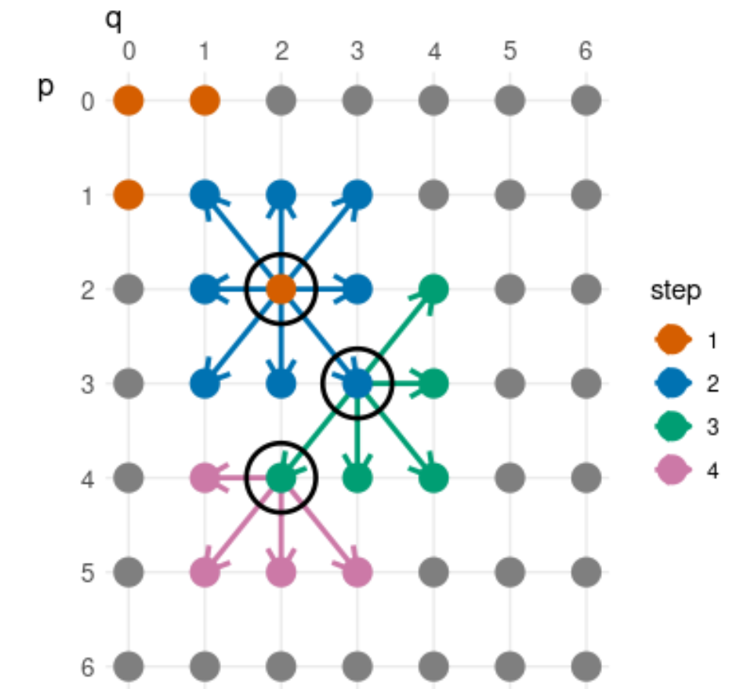
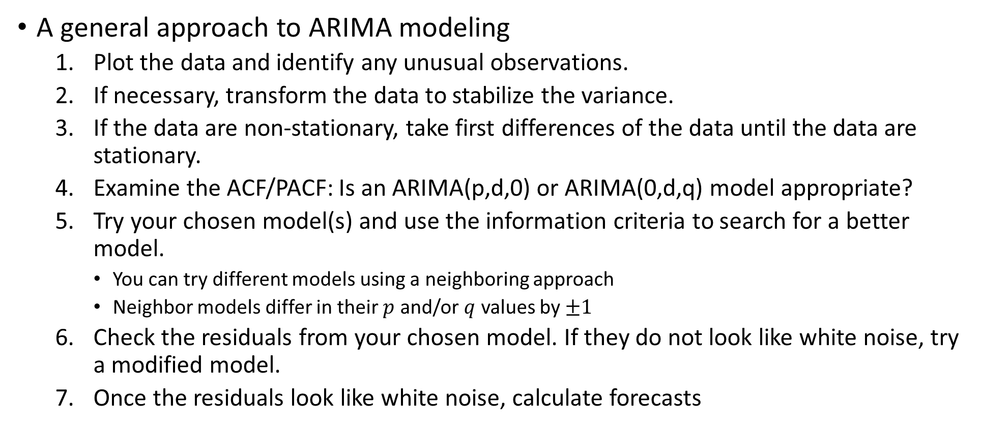
ARIMA Modeling
A general approach to ARIMA modeling
  Plot the data and identify any unusual observations.
  If necessary, transform the data to stabilize the variance.
  If the data are non-stationary, take first differences of the data until the data are stationary.
  Examine the ACF/PACF: Is an ARIMA(p,d,0) or ARIMA(0,d,q) model appropriate?
  Try your chosen model(s) and use the information criteria to search for a better model.
    You can try different models using a neighboring approach
    Neighbor models differ in their $p$ and/or $q$ values by $±1$
  Check the residuals from your chosen model. If they do not look like white noise, try a modified model.
  Once the residuals look like white noise, calculate forecasts

Slide 25
Forecasting with ARIMA
Point forecasts can be calculated using the following three steps.
  Expand the ARIMA equation so that y_{t} is on the left-hand side and all other terms are on the right.
  Rewrite the equation by replacing t with T+h
  On the right-hand side of the equation, replace future observations with their forecasts, future errors with zero, and past errors with the corresponding residuals.
Beginning with h=1, these steps are then repeated for h=2,3,… until all forecasts have been calculated.

Slide 26
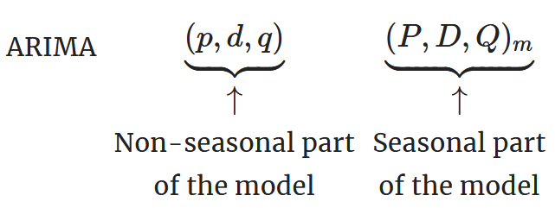
Seasonal ARIMA
ARIMA models can model a wide range of seasonal data
A seasonal ARIMA model is formed by including additional seasonal terms in the ARIMA models we have seen so far
It is written as follows:
  The seasonal part of the model consists of terms that are similar to the non-seasonal components of the model, but involve backshifts of the seasonal period

Slide 27
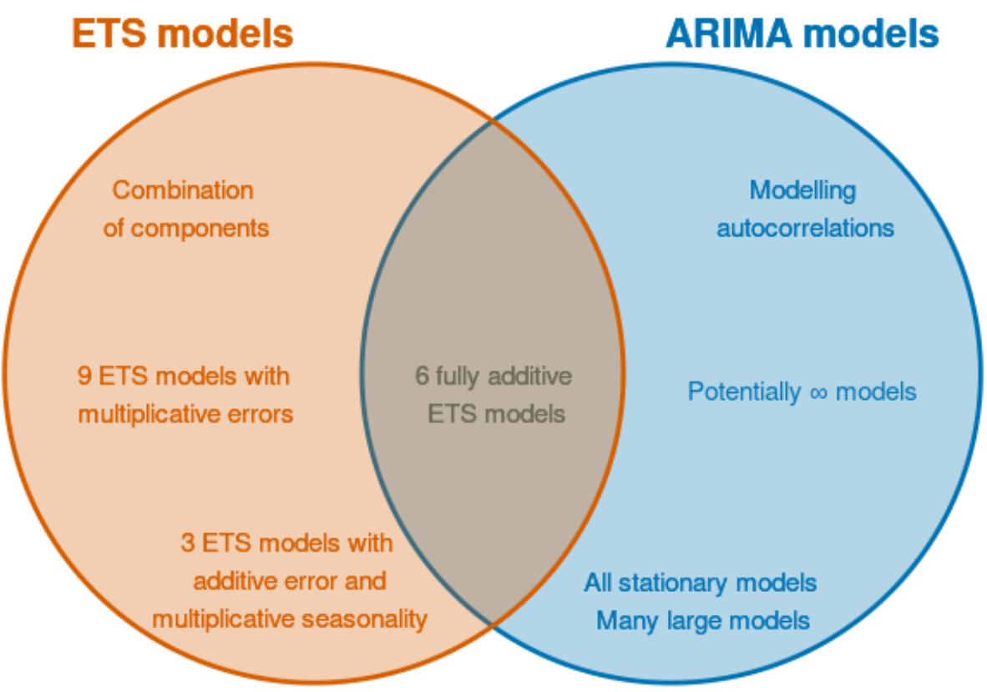
ARIMA vs. ETS
Linear ETS models are special cases of ARIMA models
  Nonlinear ETS models do not have corresponding ARIMA models
ETS models are non-stationary, ARIMA models are stationary

Slide 28
Outline
ARIMA Overview
  Introduction to ARIMA, Transformation and Differencing
  Autoregressive models, Moving Average models
  Non-seasonal ARIMA model, Order Selection and Parameter Estimation
  ARIMA Modeling and Forecasting with ARIMA, ARIMA vs. ETS
Hierarchical/Group Time Series Forecasting
  Hierarchical/Group Time Series, Single Level Forecasting Approaches
  Bottom-up, Top-down, and Middle-out Approaches

Slide 29
Hierarchical and Grouped Time Series
Time series can be naturally disaggregated by various attributes of interest
When these attributes are nested and follow a hierarchical aggregation structure, the time series is referred to as hierarchical time series
  Total sales of bikes → Road bikes, mountain bikes, hybrids
  Hybrid bikes → City bikes, commuting bikes, comfort bikes
  Usually arise due to geographical divisions
  Total sales in country, in state, in region, then city, then outlet, etc.
When these attributes are crossed rather than nested, the time series is referred to as grouped time series
  Total sales of bikes by frame size, gender, price range etc.
  These attributes do not disaggregate in a hierarchical manner

Slide 30
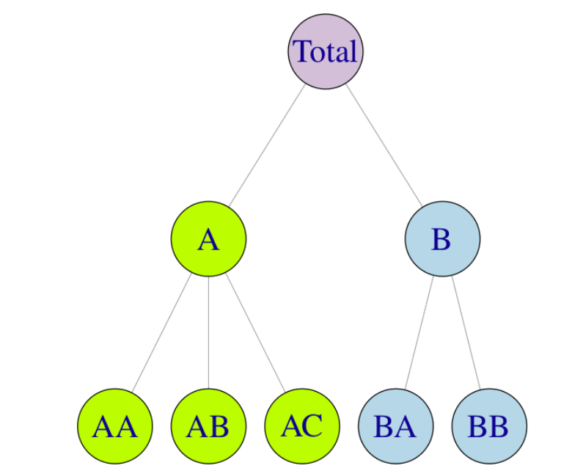



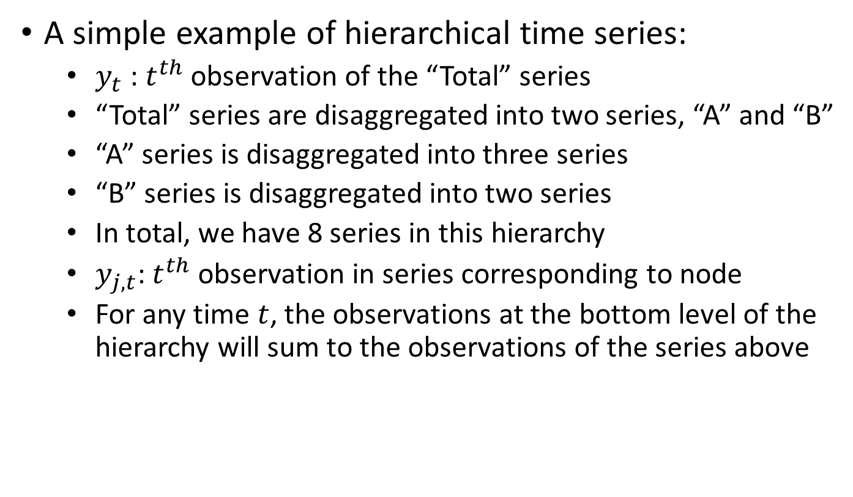
Hierarchical Time Series
A simple example of hierarchical time series:
  $y_{t}$ : $t^{th}$ observation of the “Total” series
  “Total” series are disaggregated into two series, “A” and “B”
  “A” series is disaggregated into three series
  “B” series is disaggregated into two series
  In total, we have 8 series in this hierarchy
  $y_{j,t}$: $t^{th}$ observation in series corresponding to node
  For any time $t$, the observations at the bottom level of the hierarchy will sum to the observations of the series above
Two-Level hierarchical tree diagram

Slide 31
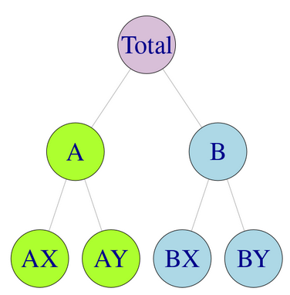
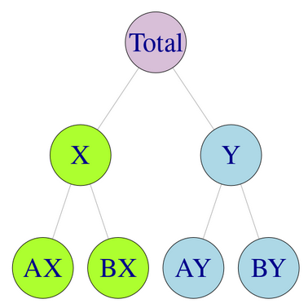
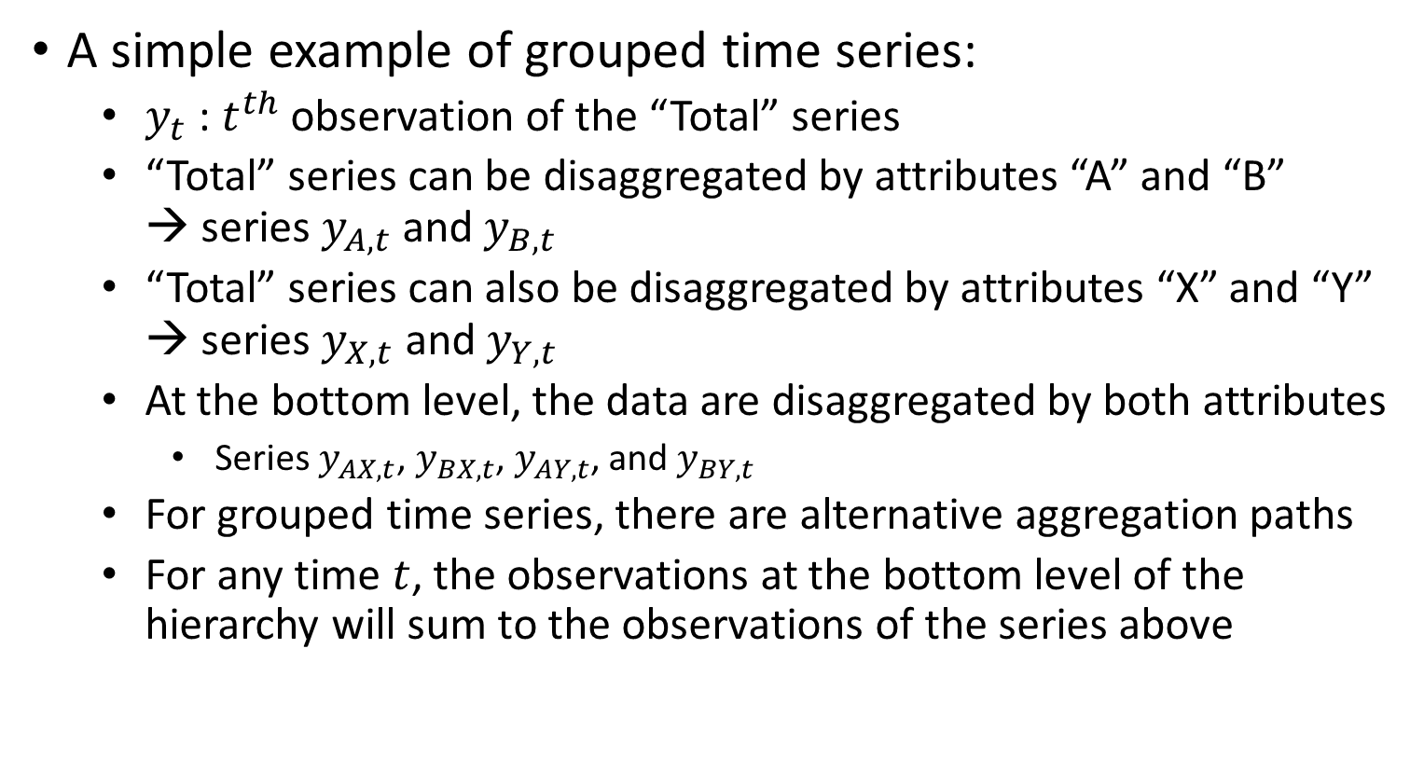
Grouped Time Series
A simple example of grouped time series:
  $y_{t}$ : $t^{th}$ observation of the “Total” series
  “Total” series can be disaggregated by attributes “A” and “B” → series $y_{A,t}$ and $y_{B,t}$
  “Total” series can also be disaggregated by attributes “X” and “Y” → series $y_{X,t}$ and $y_{Y,t}$
  At the bottom level, the data are disaggregated by both attributes
    Series $y_{AX,t}$, $y_{BX,t}$, $y_{AY,t}$, and $y_{BY,t}$
  For grouped time series, there are alternative aggregation paths
  For any time $t$, the observations at the bottom level of the hierarchy will sum to the observations of the series above
    Grouped time series can sometimes be thought of as hierarchical time series that do not impose a unique hierarchical structure, in the sense that the order by which the series can be grouped is not unique.

Slide 32
Single Level Forecasting Approaches
Typically, forecasts would be required for all disaggregate and aggregate series
  The forecasts should add up similar to the data
    Forecasts of state-level sales should add up to forecast of country-level sales
Forecasting approach should be coherent across the entire aggregation structure
  Forecasts will add up in a manner consistent with the structure of hierarchy and groups
More complex structures arise when attributes of interest are both nested and crossed
  Mixed hierarchical and grouped time series
    Sales by product type and geographic region

Slide 33
Single Level Forecasting Approaches
Traditionally, forecasts of hierarchical or grouped time series involves selecting one level of aggregation and generating forecasts for that level.
These are then either aggregated for higher levels, or disaggregated for lower levels, to obtain a set of coherent forecasts for the rest of the structure.
Basic single-level approaches:
  Bottom-up
  Top-down
  Middle-out

Slide 34
Bottom-up Approach
A simple method for generating coherent forecasts
How it works?
  First, generate forecasts for each series at the bottom level
  Then, sum bottom level forecasts to produce forecasts for all the series in the structure
Advantage: Forecasting at the bottom level of the structure, so no information is lost due to aggregation
Disadvantage: Bottom-level data can be quite noisy, hence, might be challenging to model and forecast

Slide 35
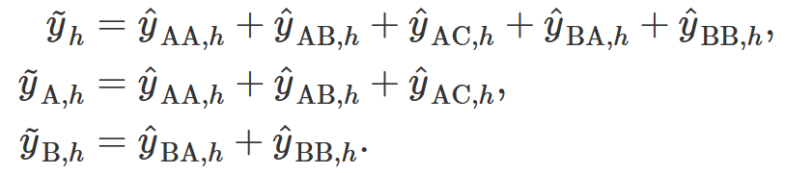
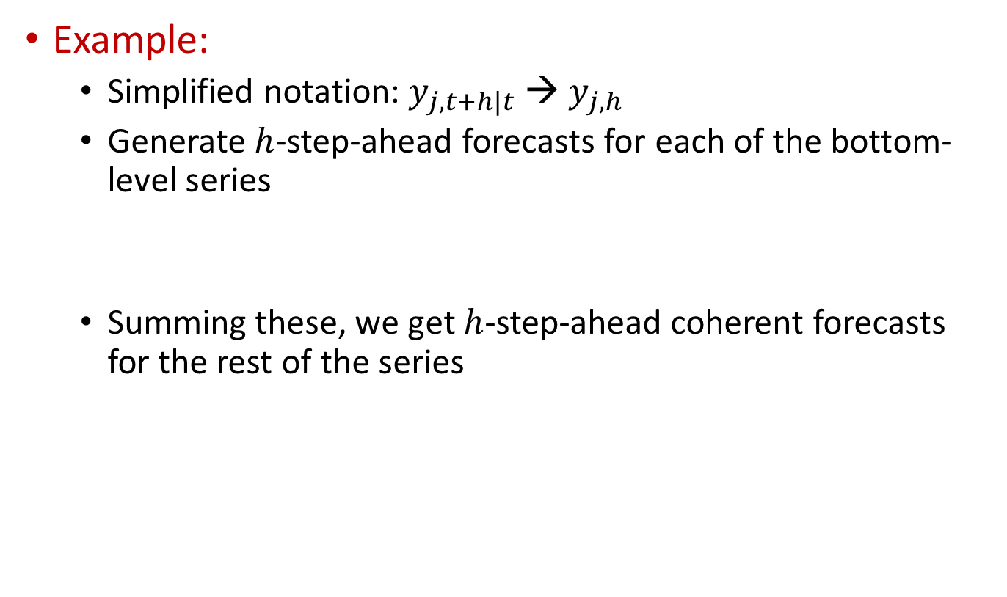
Bottom-up Approach
Example:
  Simplified notation: $y_{j, t+h|t}$ → $y_{j, h}$
  Generate $h$-step-ahead forecasts for each of the bottom-level series
  Summing these, we get $h$-step-ahead coherent forecasts for the rest of the series

Slide 36
Top-down Approach
Relies on proportions for generating coherent forecasts
  Proportions determine how the forecasts of the “total” series will be distributed to calculate the forecasts at the bottom level
How it works?
  First, generate forecasts for the top level “total” series
  Then, disaggregate top-level forecast down the hierarchy using proportions
There are alternative top-down methods
  These differ in how proportions are calculated
  Most common methods use historical proportions

Slide 37







Top-down Approach
Let $p_{1}, p_{2},…,p_{m}$ denote the disaggregation proportions to calculate the forecasts of the bottom level series from the total series
Example:
  Using $p_{1}, p_{2},…,p_{5}$ for proportions of AA, AB, AC, BA, and BB
Using these bottom-level forecasts, we can calculate the coherent forecasts of the other series in the structure
For instance:
  ${\tilde{y}}_{B,t}={\tilde{y}}_{BA,t}+{\tilde{y}}_{BB,t}$

Slide 38
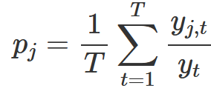
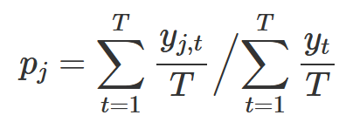
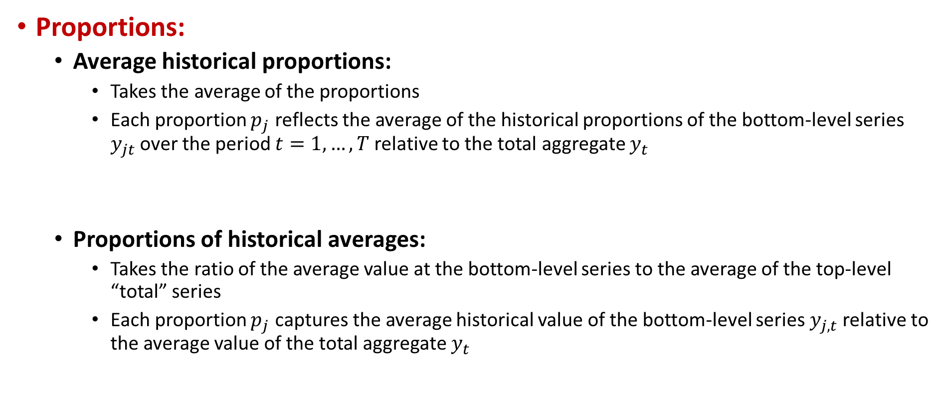
Top-down Approach
Proportions:
  Average historical proportions:
    Takes the average of the proportions
    Each proportion $p_{j}$ reflects the average of the historical proportions of the bottom-level series $y_{jt}$over the period $t=1,…,T$relative to the total aggregate $y_{t}$
  Proportions of historical averages:
    Takes the ratio of the average value at the bottom-level series to the average of the top-level “total” series
    Each proportion $p_{j}$ captures the average historical value of the bottom-level series $y_{j,t}$relative to the average value of the total aggregate $y_{t}$

Slide 39
Top-down Approach
Proportions:
  Forecast proportions:
    The other approaches do not account for changes in proportions
    To this end, proportions based on forecasts can be used
      Generate the forecasts for all of the series → initial forecasts
      Then, calculate the proportion of a node to the aggregate forecasts of all nodes at the same level
      These are the forecast proportions
      Use the forecast proportions to disaggregate the upper-level forecast to generate coherent forecasts
    This is repeated for each node, going from top to the bottom level

Slide 40
Middle-out Approach
Combines bottom-up and top-down approaches
How it works?
  A ‘middle’ level is chosen, and forecasts are generated for all the series at this level
  For the series above the middle level, coherent forecasts are generated using the bottom-up approach by aggregating the “middle-level” forecasts upwards.
  For the series below the “middle level”, coherent forecasts are generated using a top-down approach by disaggregating the “middle level” forecasts downwards.

